Slide 1
RNAseq / Affymetrix data
Bioinfo workflow
Normalization
Dorothea TF-Target Network
Differential gene expression
Transcription factor activity
abs(logFC) > 0.75
p.value < 0.1
p.value < 0.1
Reactome Protein-Protein Interaction network
Network
Network analysis
Network Visualisation
Eigen Centrality & PageRank

Slide 2
Datasets tables
Koichi
TCGA
Response to IDH inhibitors
Good Responders |  | Bad Responders |  | Relapse
Complete Remission | CRi + incomplete hematologic recovery | Stable disease | Progressive disease | Previously BR or OR
17 | 1 | 31 | 1 | 10
Impact of IDH mutation
IDH wt | IDHm
143 | 37
Verhaak
Verhaak
Response to chimio depending IDH states
IDH wt |  | IDHm
OS > 300d | OS < 300d | OS > 300d | OS < 300d
195 | 155 | 41 | 27
Impact of IDH mutation
IDH wt | IDHm
350 | 68

Slide 3
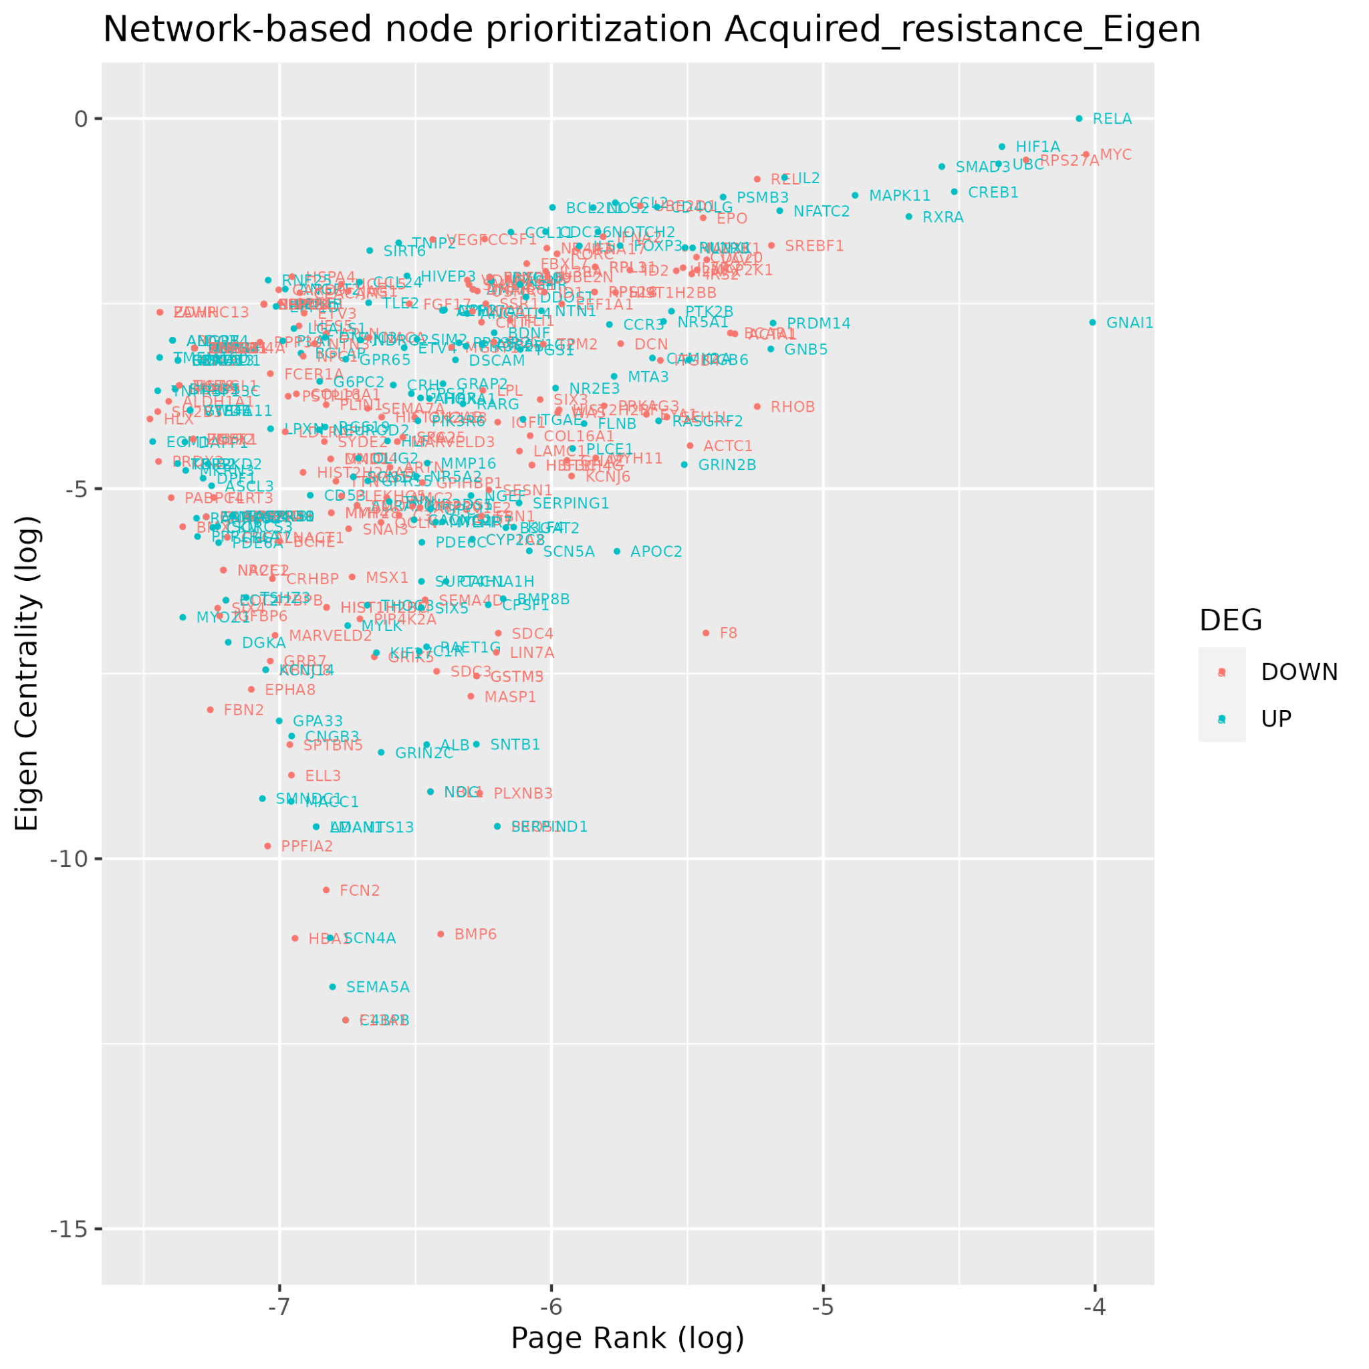
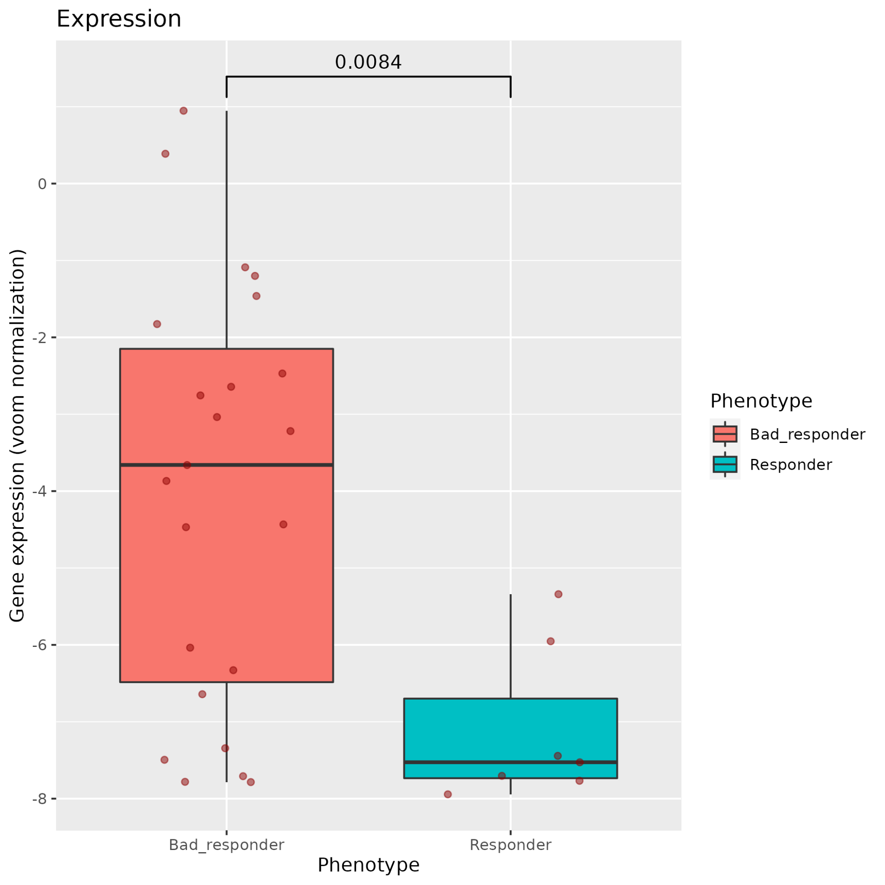
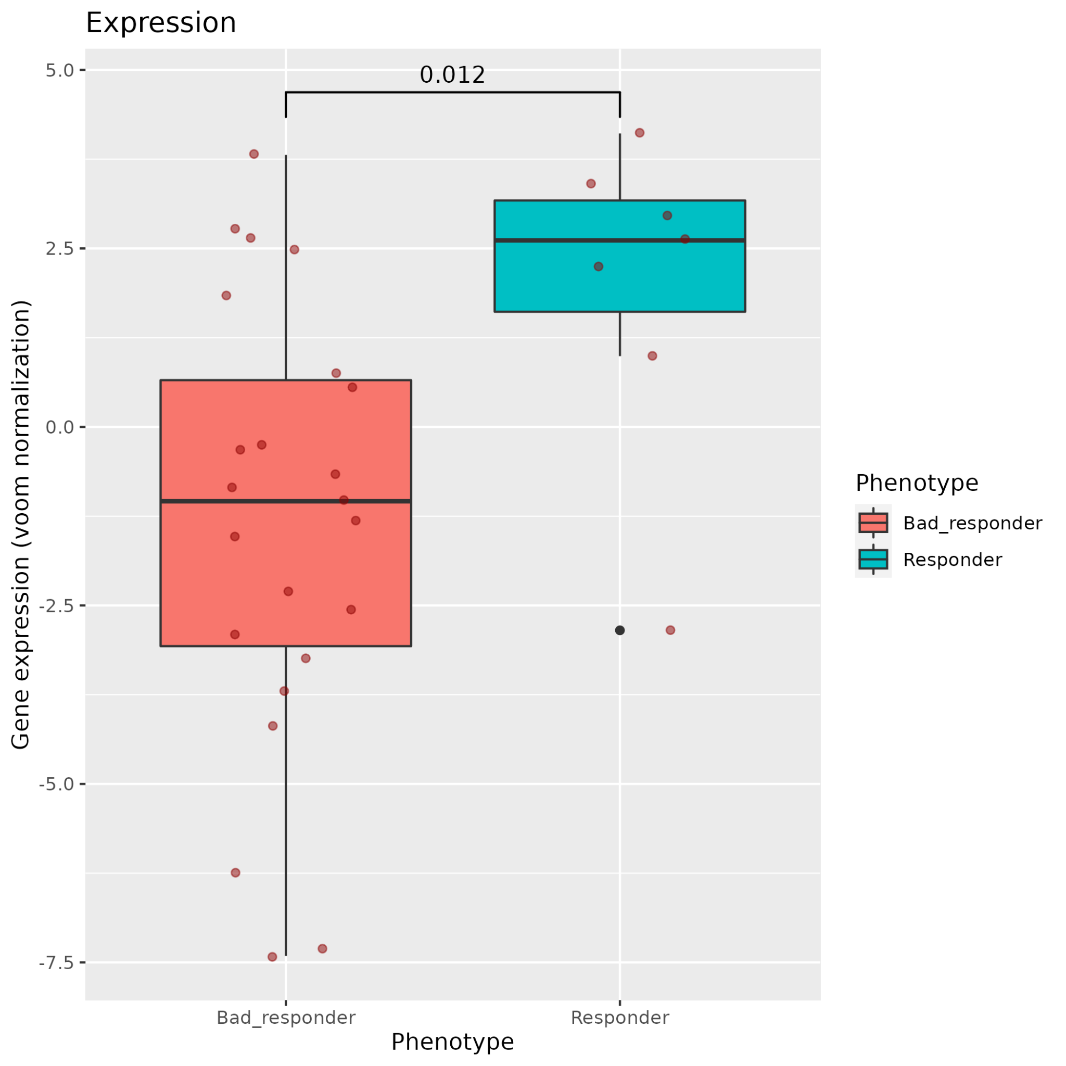
RELA
MYC

Slide 4
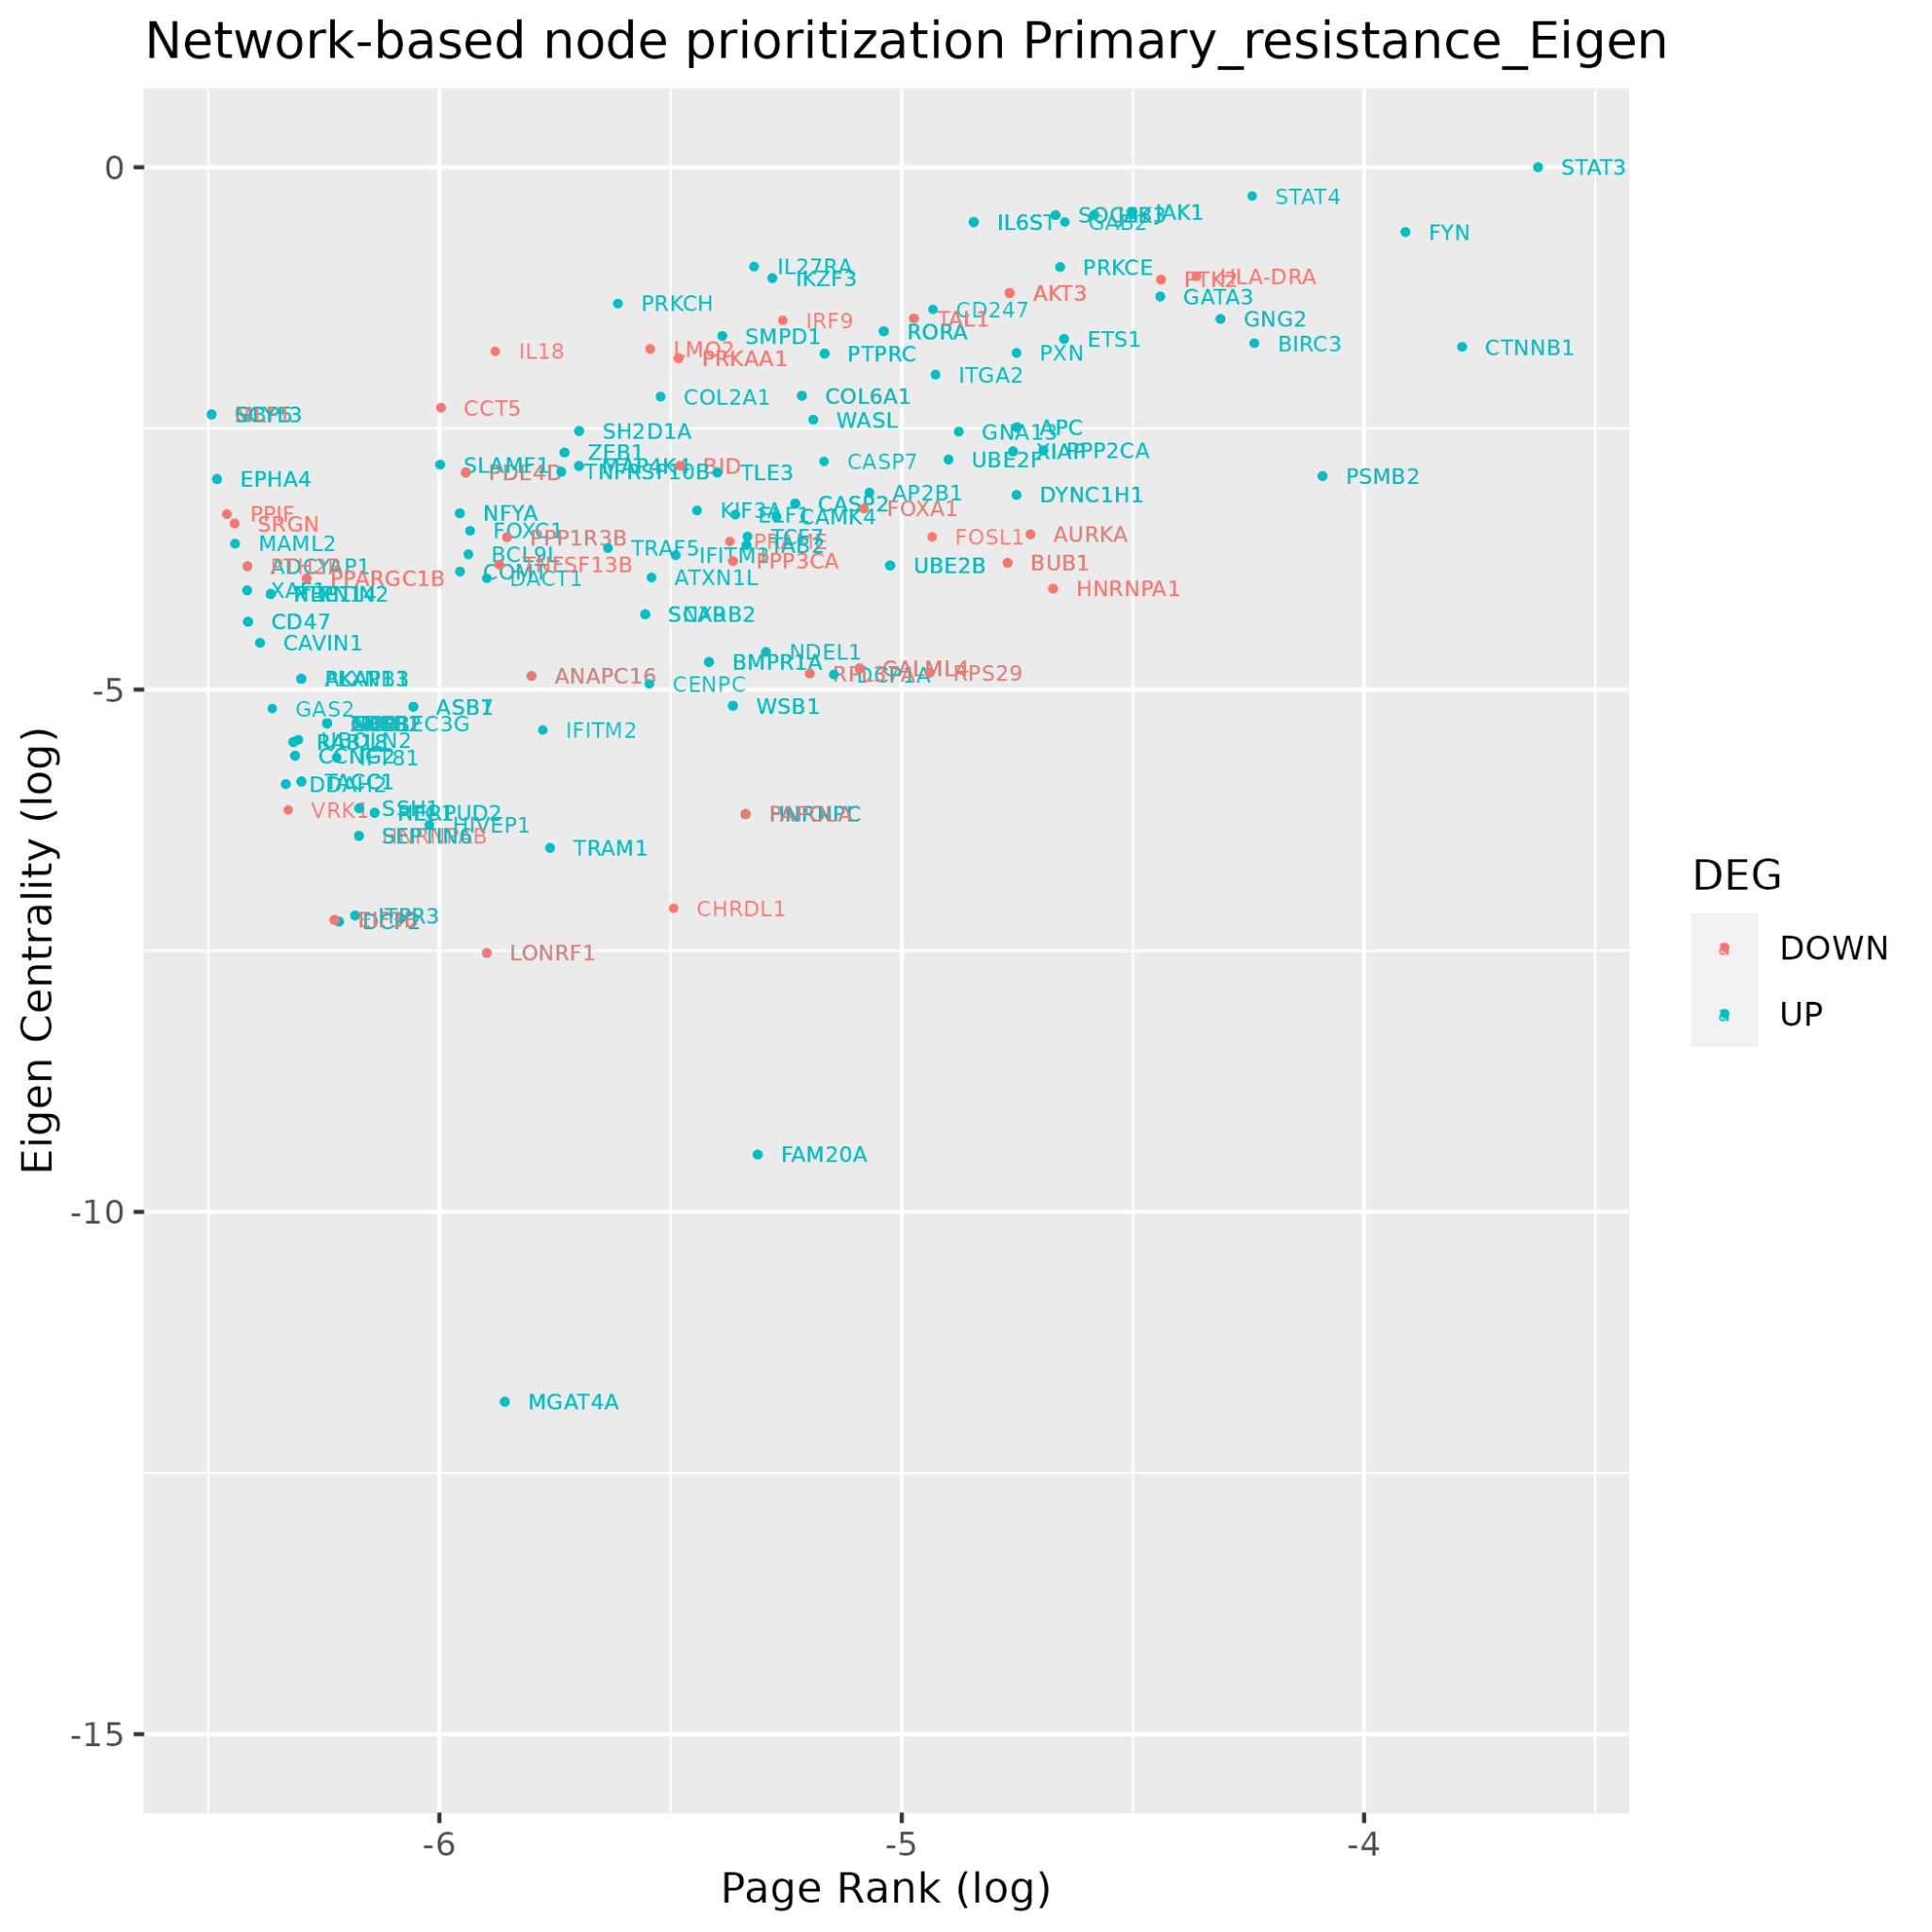
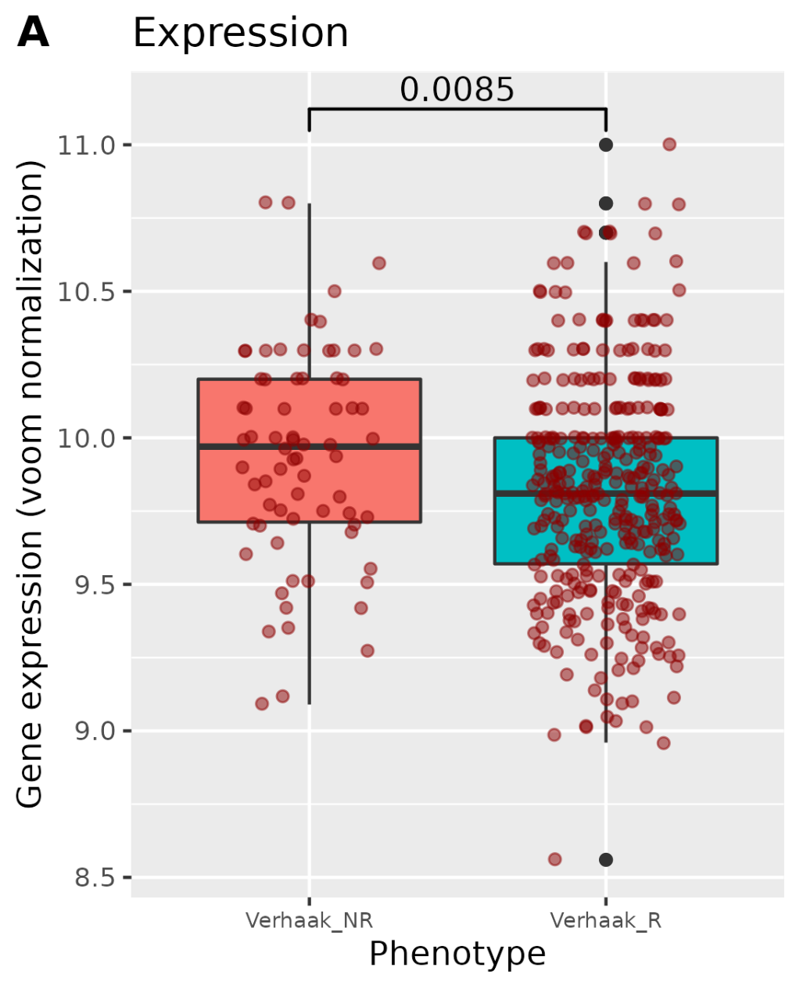
STAT3

Slide 5
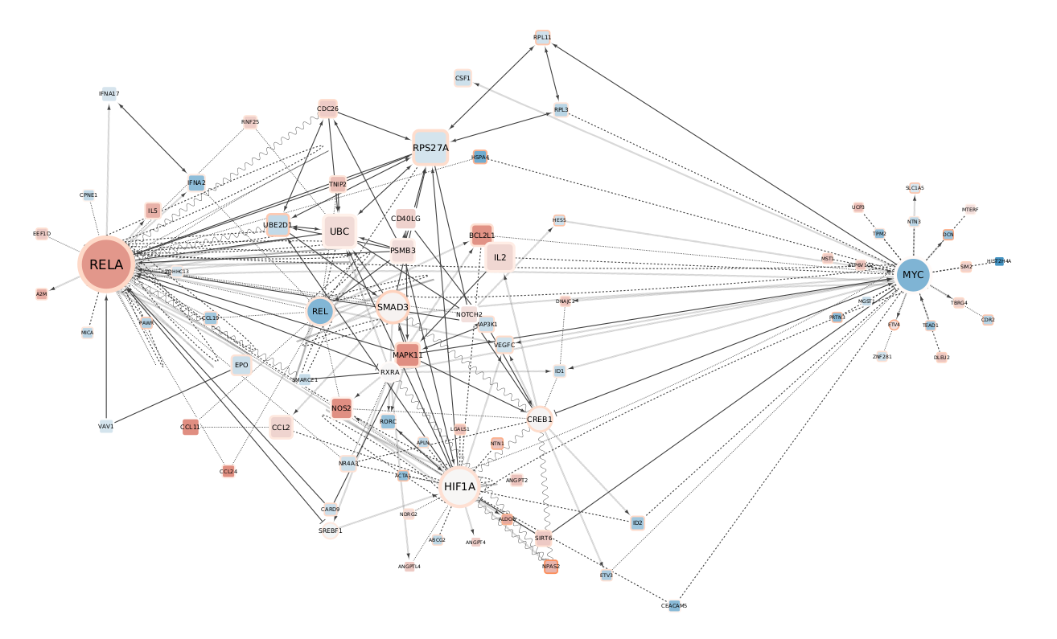
Acquired resistance centered network

Slide 6
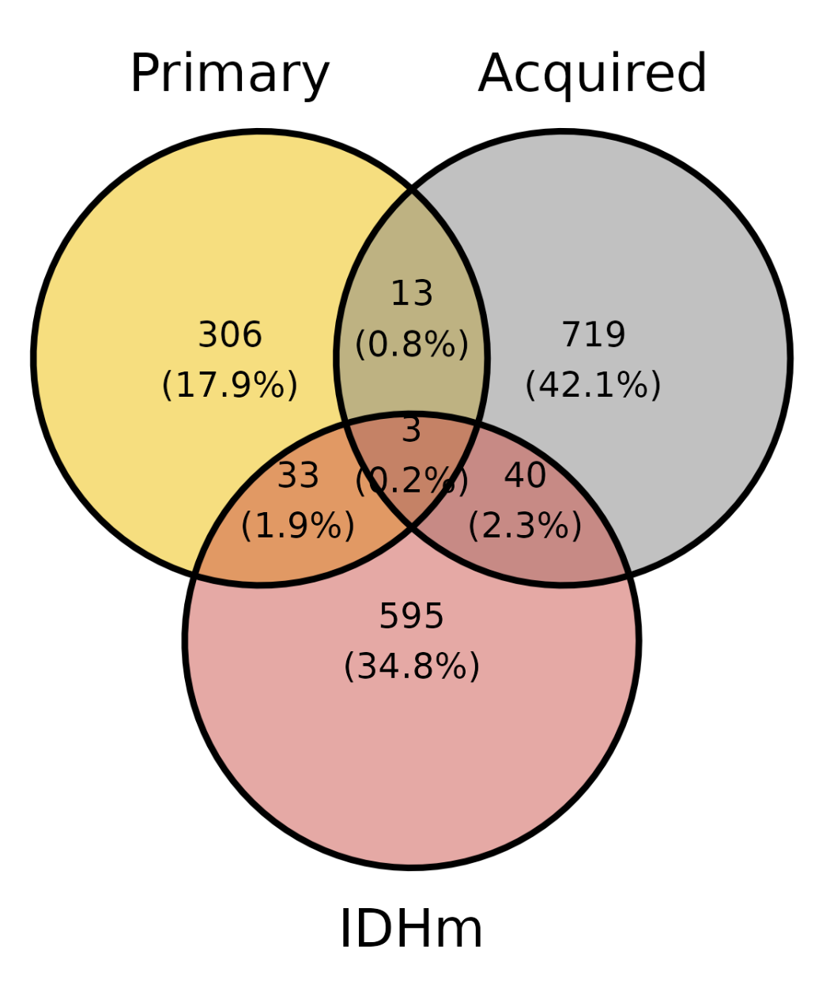
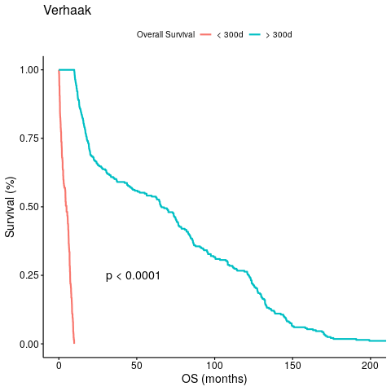
"GAS2" "PGBD1" "RRAS2"

Slide 7
